Slide 1


Slide 2
/r/
T1

Slide 3
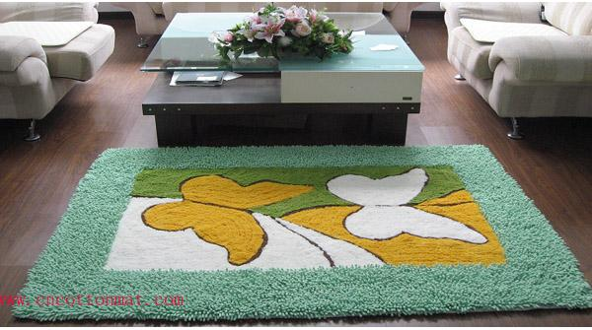
1
/r/
T2

Slide 4
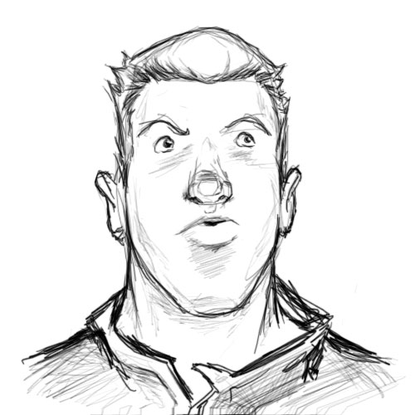
/r/
T3

Slide 5
/m/
T4

Slide 6


/m/
T5

Slide 7
/p/
01

Slide 8


/p/
02

Slide 9
/p/
03

Slide 10
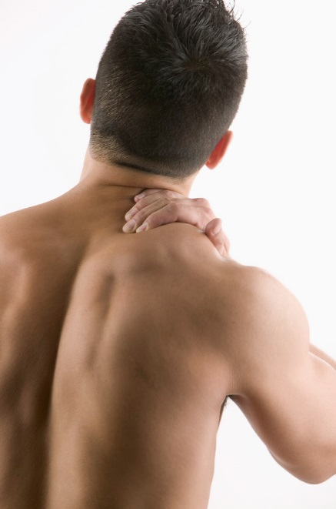
/p/
04

Slide 11
/p/
05

Slide 12
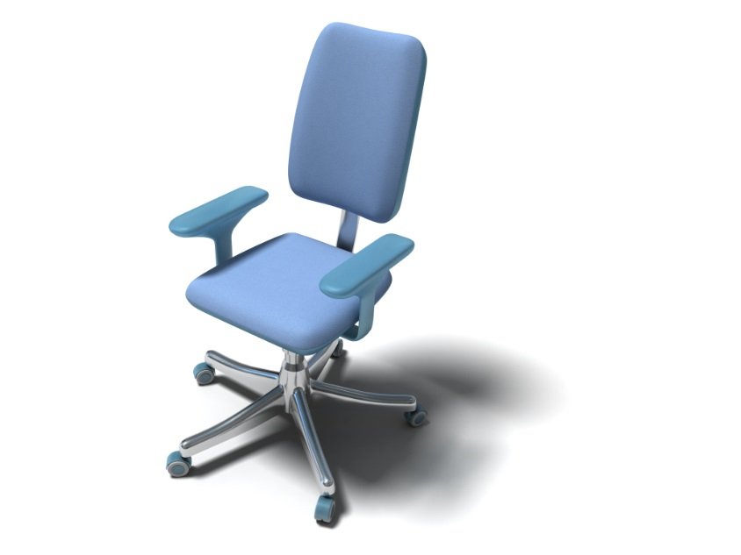

06
/ʧ/

Slide 13
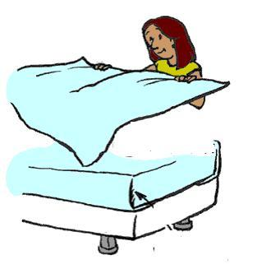
/ʧ/
07

Slide 14


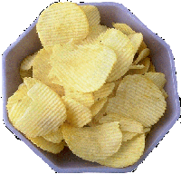
/ʧ/
08

Slide 15

/ʧ/
09

Slide 16
/ʧ/
10

